Slide 1


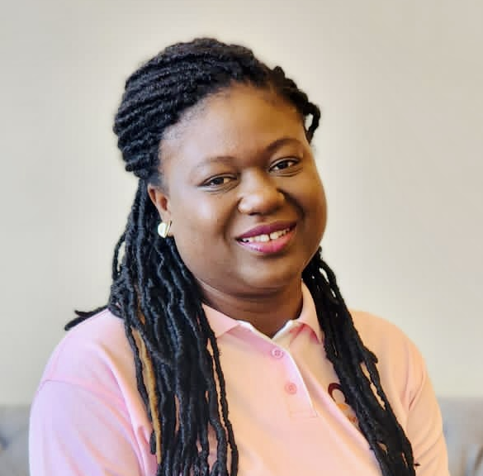
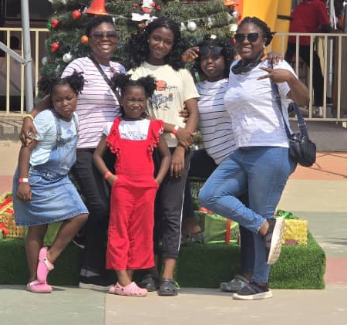
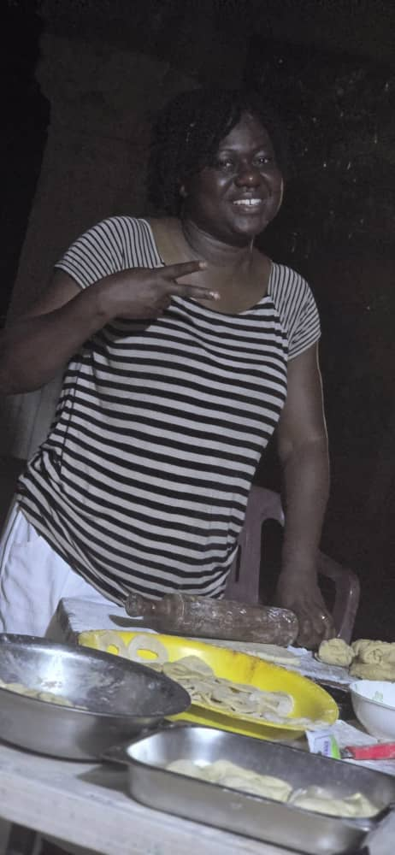
Getting to Know Me
Work
Personal
My role
Non- Commodity Procurement Manager
Significant others / family members / furry friends in my life
Husband, my 4 girls, my sister and parents
Tenure in ofi/Olam
16 years
How I enjoy spending my free time
Love to cook and spend time with my family
Previous companies I have worked at
USAID (GAIT II Project)
My favorite / comfort food
Fufu and green soup
Why I joined ofi/Olam and what keeps me here?
Wanted a challenging and engaging
My favorite song
Dream it possible (Delacey)
Sylvia Araba Amo-Asare
‘Araba’
A few fun facts about me
Still enjoy watching Rambo and E. T
This is me outside work, doing stuff I enjoy in my life …

